Slide 1
Sector Based Trade Recommendation System
Presented By:
Rujuta Palimkar
Vidisha Pandey
Shilpa Jagtap
Mandira Samjiskar
Gargi Kulkarni

Slide 2
AGENDA
Section 1 : • Problem Statement
• Introduction
• Project Overview
Section 2 : • System working
• Databases
• Business Logic
• User Interface
Section 3 : • Conclusion
• Project Demonstration
• Q & A

Slide 3
PROBLEM STATEMENT
Sector based Trade Recommendation System
Construct a trade recommendation system based on user-selected sectors (from Nifty stocks)

Slide 4
INTRODUCTION
WHAT IS “TRADING RANGE”?
A trading range is the spread between the high and low prices traded during a period of time.
When a stock breaks through or falls below its trading range after several days of trading in a range, it usually means there is momentum (positive or negative) building.

Slide 5
PROJECT OVERVIEW
Technologies Used :
• Programming Language: Java , HTML, CSS, AngularJS
• IDE: Spring Tool Suite
• Database: MongoDB
• Web Service: Yahoo Finance API
• Server : Apache Tomcat Server

Slide 6
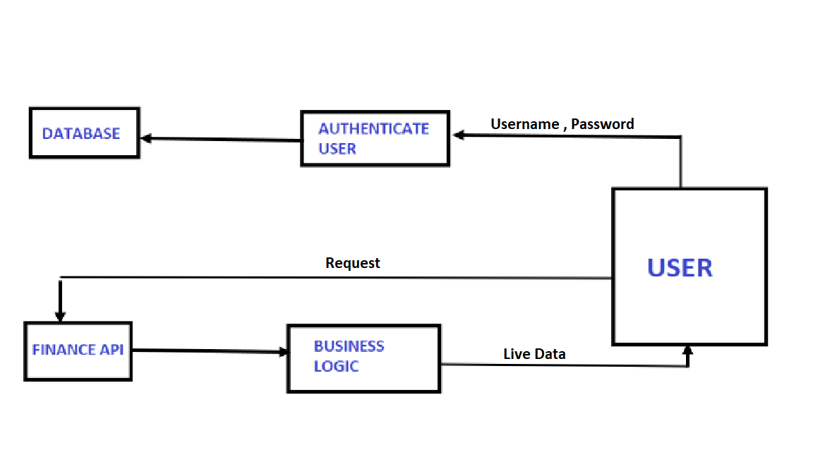
SYSTEM ARCHITECTURE

Slide 7
SCOPE OF THE PROJECT
The Sector Based Recommendation System allows the registered user to view the value of the stock prices at Nifty of the selected sector at the given instance of time.
User logs in to system with a username and a password.
User selects a market sector(Automotive, financial, Health Care, Technology etc.) in order to get suggestions on securities.
The user is allowed to view the top recommendations, accumulated over the two weeks’ data that provide the best trading opportunities.

Slide 8
SCOPE OF THE PROJECT
For these stocks, used live market data and as output displaying key attributes of top performing stocks of particular sector.
User is able select to save any of the recommended stocks with quantity and current market price.
When the user logs in again the user is able to see the saved stocks and key attributes.

Slide 9

BUSINESS LOGIC
Trade recommendation system takes live market data for specific sector based companies from Yahoo Finance API.
Data is taken for the period of 2 weeks.
The fetched data is run under the expression
$\frac{High \left(today\right)−High (2 weeks ago)}{High (2 weeks ago)}×100$
to get the percentage of gain over the time duration.
The data is hence sorted in descending order to get the top five performing stocks.
This processed data is then displayed in the user interface where the user can wish to save the data for that day, which is stored in the database.

Slide 10
BACKEND
Created on Spring Tool Suite(STS) using object oriented Java Programming language
Use of DAO , Dependencies and Annotations in STS.
Design Patterns/Techniques Used: RESTful web services

Slide 11
RESTFUL WEB SERVICE
Features:
• Any interface between systems using HTTP to obtain data and generate operations on those data in all possible formats
• The most logical, efficient and widespread standard in the creation of APIs for Internet services.
• The four very important data transactions in any REST system and HTTP specification: POST (create),GET(read and consult),PUT (edit) and DELETE.

Slide 12
USER INTERFACE
Use of HTML + CSS + AngularJS Features of AngularJS:
AngularJS is a structural framework for dynamic web apps.
It lets you use HTML as your template language and lets you extend HTML's syntax to express your application's components clearly .
Angular’s components based approach is easy to follow.
It all happens within the browser, making it an ideal partner with any server technology.
Use of Directives

Slide 13
Project Demonstration

Slide 14
Thank You!!

